Slide 1
EMPLOYEE DATA ANALYSIS USING EXCEL
STUDENT NAME: MAHESWARI G
REGISTER NUMBER: 2213331042113
DEPARTMENT: COMMERCE
COLLEGE: BHARATHI WOMEN’S COLLEGE

Slide 2
PROJECT TITLE
Employee Turnover Analysis Using Excel

Slide 3
agenda
Problem statement
Project overview
End users
Our solution and preposition
Dataset description
Modelling approach
Results and discussion
conclusion

Slide 4
Problem statement
The organization has been experiencing a noticeable increase in employee turnover, leading to concerns about the underlying causes and the potential impact on business operations. There is a need to analyse the turnover data to identify patterns and trends that may indicate critical issues such as high turnover in specific department, among particular demographic groups or at certain tenure lengths. The goal is to use excel to conduct a detailed analysis, including calculating turnover rates and enhance employee satisfaction.

Slide 5
Project overview
This project focuses on analysing employee turnover within the organisation using excel. The analysis aims to identify patterns, trends and potential root causes of turnover by examining key matrices such as turnover rates, tenure, and demographic factors. data visualization tools like chart and pivot table will be used to highlight critical areas such as department and employee groups with high turnover.

Slide 6
Who are the end users ?
HR MANAGERS: To Identify Turnover Patterns And Implement Retention Strategies.
DEPARTMENT HEADS: To Monitor Turnover In Their Teams And Address Potential Issues.
SENIOR MANAGEMENT: To Make Informed Decisions About Workforce Planning And Organizational Strategies.
FINANCIAL ANALYSTS: To Assess The Financial Impact Of Turnover On The Organization.
IT SUPPORT TEAMS: To Maintain And Update The Excel Based Analysis Tools As Needed.

Slide 7
Our solution and preposition
We Propose A Comprehensive Excel Based Employee Turnover Analysis Tool That Enables Hr And Management To Track, Visualize, And Understand Turnover Trends. This Solution Will Identify Critical Areas Where Turnover Is Highest, Allowing For Targeted Interventions To Improve Retention. By Leveraging Data Insights, The Organization Can Enhance Workforce Stability, Reduce Costs Associated With High Turnover, And Ultimately Boost Overall Employee Satisfaction. This Data Driven Approach Empowers The Organization To Develop Effective Retention Strategies Tailored To The Unique Needs To Different Departments Or Employee Segments, Ultimately Supporting Long Term Organizational Growth And Stability.

Slide 8
Dataset description
The Dataset For This Project Includes Employee Specific Information Such As Employee Id, Department, Job Title, Gender Age, Hire Date, And Termination Date. It Also Captures Reasons For Leaving, Tenure Length, And Turnover Status (Whether An Employee Is Active Or Has Left). Additionally, Demographic Data Such As Age And Gender Will Be Used To Analyse Turnover Trends Across Different Groups. The Data Covers Multiple Time Periods, Allowing For Trend Analysis Over Months Or Years. This Structured Dataset Will Be Crucial For Generating Insights And Guiding Retention Strategies.

Slide 9
The “wow” in our solution
The wow factor lies in its ability to not only analyse past turnover trends but also predict future challenges through dynamic forecasting models. This tool allows you to drill down into specific departments, demographics and tenure groups, revealing hidden patterns and enabling highly targeted interventions. Moreover, the solution automation features ensure that decision-makers always have up-to-date data at their fingertips, transforming raw information into a powerful, strategic asset for enhancing workforce stability and driving organisational success.

Slide 10
modelling
To Model Employee Turnover Analysis In Excel Start By Collecting Employee Data ( E.G., Hire Dates, Termination Dates, Department, Age And Reasons For Leaving ). Calculate Key Metrics Like Turnover Rate And Average Tenure, And Visualize These Using Charts To Identify Trends And Patterns. Incorporate Predictive Modelling Techniques, Such As Linear Regression And Trendlines To Forecast Future Turnover Rates.

Slide 11
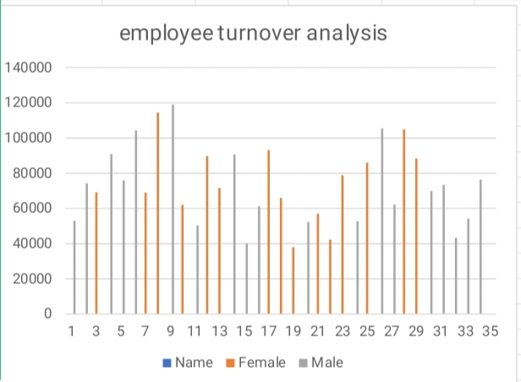
results

Slide 12
conclusion
Conducting an employee turnover analysis using excel offers a powerful, cost-effective way to gain insights into workforce dynamics and address retention challenges. By systematically collecting and analysing data, organizations can identify trends and patterns that may be contributing to high turnover. The use of excel ’s analytics and visualization tools enables decision makers to pinpoint critical areas of concern, such as departments with higher-than-average turnover rates or specific rates or specific demographic groups at risks. ultimately, this analysis empowers organizations to develop targeted strategies that enhance employee turnover and improve performance.

Slide 13
thank you

